Slide 1
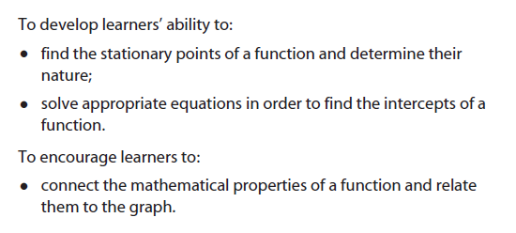

Slide 2
Starter – differentiate:

Slide 3
Tasks
Work in pairs
Choose a function
Set A are normal challenge, set B are medium challenge and set C are high challenge
Explore your chosen function (i.e. find out all you can about the intercepts, stationary points, and their nature)
Draw a good quality sketch of the function based on this
All rough work, working out and thinking must be written on A3 large sheet of paper, which will become a poster

Slide 4
